Slide 1



BOSTON CRIME
Carter Bentinganan
Christopher Lue
Duygu Simsek
Kimberly Smith

Slide 2


Today’s Agenda
Background
Purpose
Analysis
Machine Learning
Dashboard

Slide 3


BACKGROUND
What is a crime?
Why did we choose the city of Boston?
Notes:
Crime is one of the complex social problems that has grown over time with the increase in population and has significant impacts directly on victims and indirectly on the community. No society in any part of the world is without crime.
Boston is the capital and most crowded city of the Commonwealth of Massachusetts in the United States and the 24th-most populous city in the country. Boston has one of the highest crimes in the United States.
It has been recorded 4,378 violent crimes in 2020 in Boston, giving it a violent crime rate of 6.48 per 1,000 people. There were 58 murders, 193 rapes, 923 robberies, and 3,204 sex assaults.

Slide 4
Purpose of analysis
This analysis aims to provide proper police staffing by determining the frequencies, times, and locations crimes are committed.
With this analysis, we’ve focused to answer these questions:
Is it possible to predict where or when a crime will be committed?
How has crime changed over the year?
Does the frequency of crimes change over a day? Weeks? Months?
What types of crimes are most common?
In which area or district most crimes are committed?
Where are the best places for police stations?

Slide 5
ANALYSIS
EXTRACT
The data was extracted from https://data.boston.gov/dataset/crime-incident-reports-august-2015-to-date-source-new-system/resource/f4495ee9-c42c-4019-82c1-d067f07e45d2.
We downloaded the CSV file containing the crime data from 2021.
TRANSFORM
The data was cleaned by taking out the null values and irrelevant columns were deleted. Data frames were created with the clean dataset.
LOAD
The data was loaded and stored in SQL.
Notes:
In our dataset, there were 17 variables:
Incident Number
Offense Code
Offense Description
Offense Code Group
District, Reporting Area
Shooting
Occurred on Date
Month, Year, Hour
UCR Part
Street
Latitude, Longitude, and Location.
Many of these variables had duplicate information. So, duplicate variables were dropped. Also, because the Offense Code Group and UCR part columns had null values, they were dropped to have cleaner and more organized dataset.
Reporting Area, Latitude, and Longitude columns were dropped to provided similar information with the District and Location columns, respectively.
Year column was dropped because all the data was from the year 2021. After further analysis, it was determined that we could also drop Street and Location in order to create our first K-Means clusters.

Slide 6






TECHNOLOGIES
Technologies we used:

Slide 7
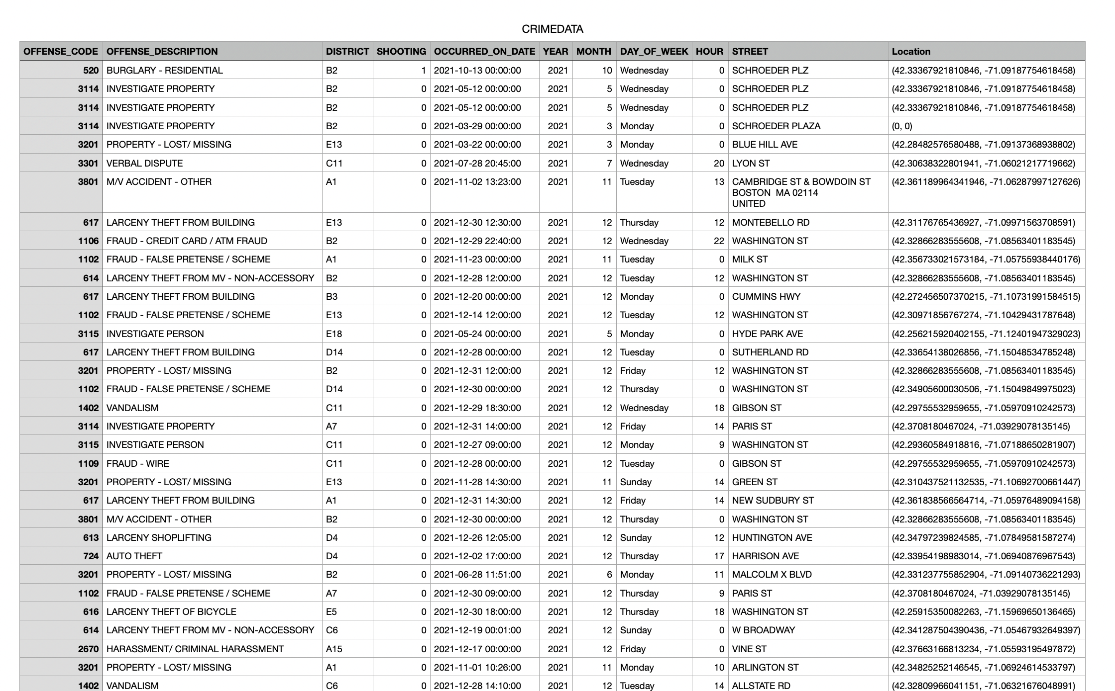

Data frame
Notes:
In our dataset, there were 17 variables:
Incident Number
Offense Code
Offense Description
Offense Code Group
District, Reporting Area
Shooting
Occurred on Date
Month, Year, Hour
UCR Part
Street
Latitude, Longitude, and Location.
Many of these variables had duplicate information. So, duplicate variables were dropped. Also, because the Offense Code Group and UCR part columns had null values, they were dropped to have cleaner and more organized dataset.
Reporting Area, Latitude, and Longitude columns were dropped to provided similar information with the District and Location columns, respectively.
Year column was dropped because all the data was from the year 2021. After further analysis, it was determined that we could also drop Street and Location in order to create our first K-Means clusters.

Slide 8
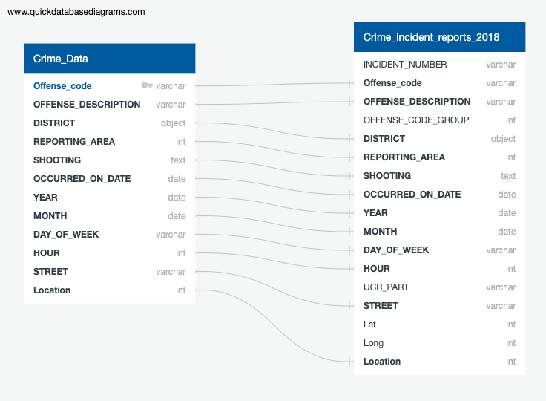
DATABASE DIAGRAMS

Slide 9
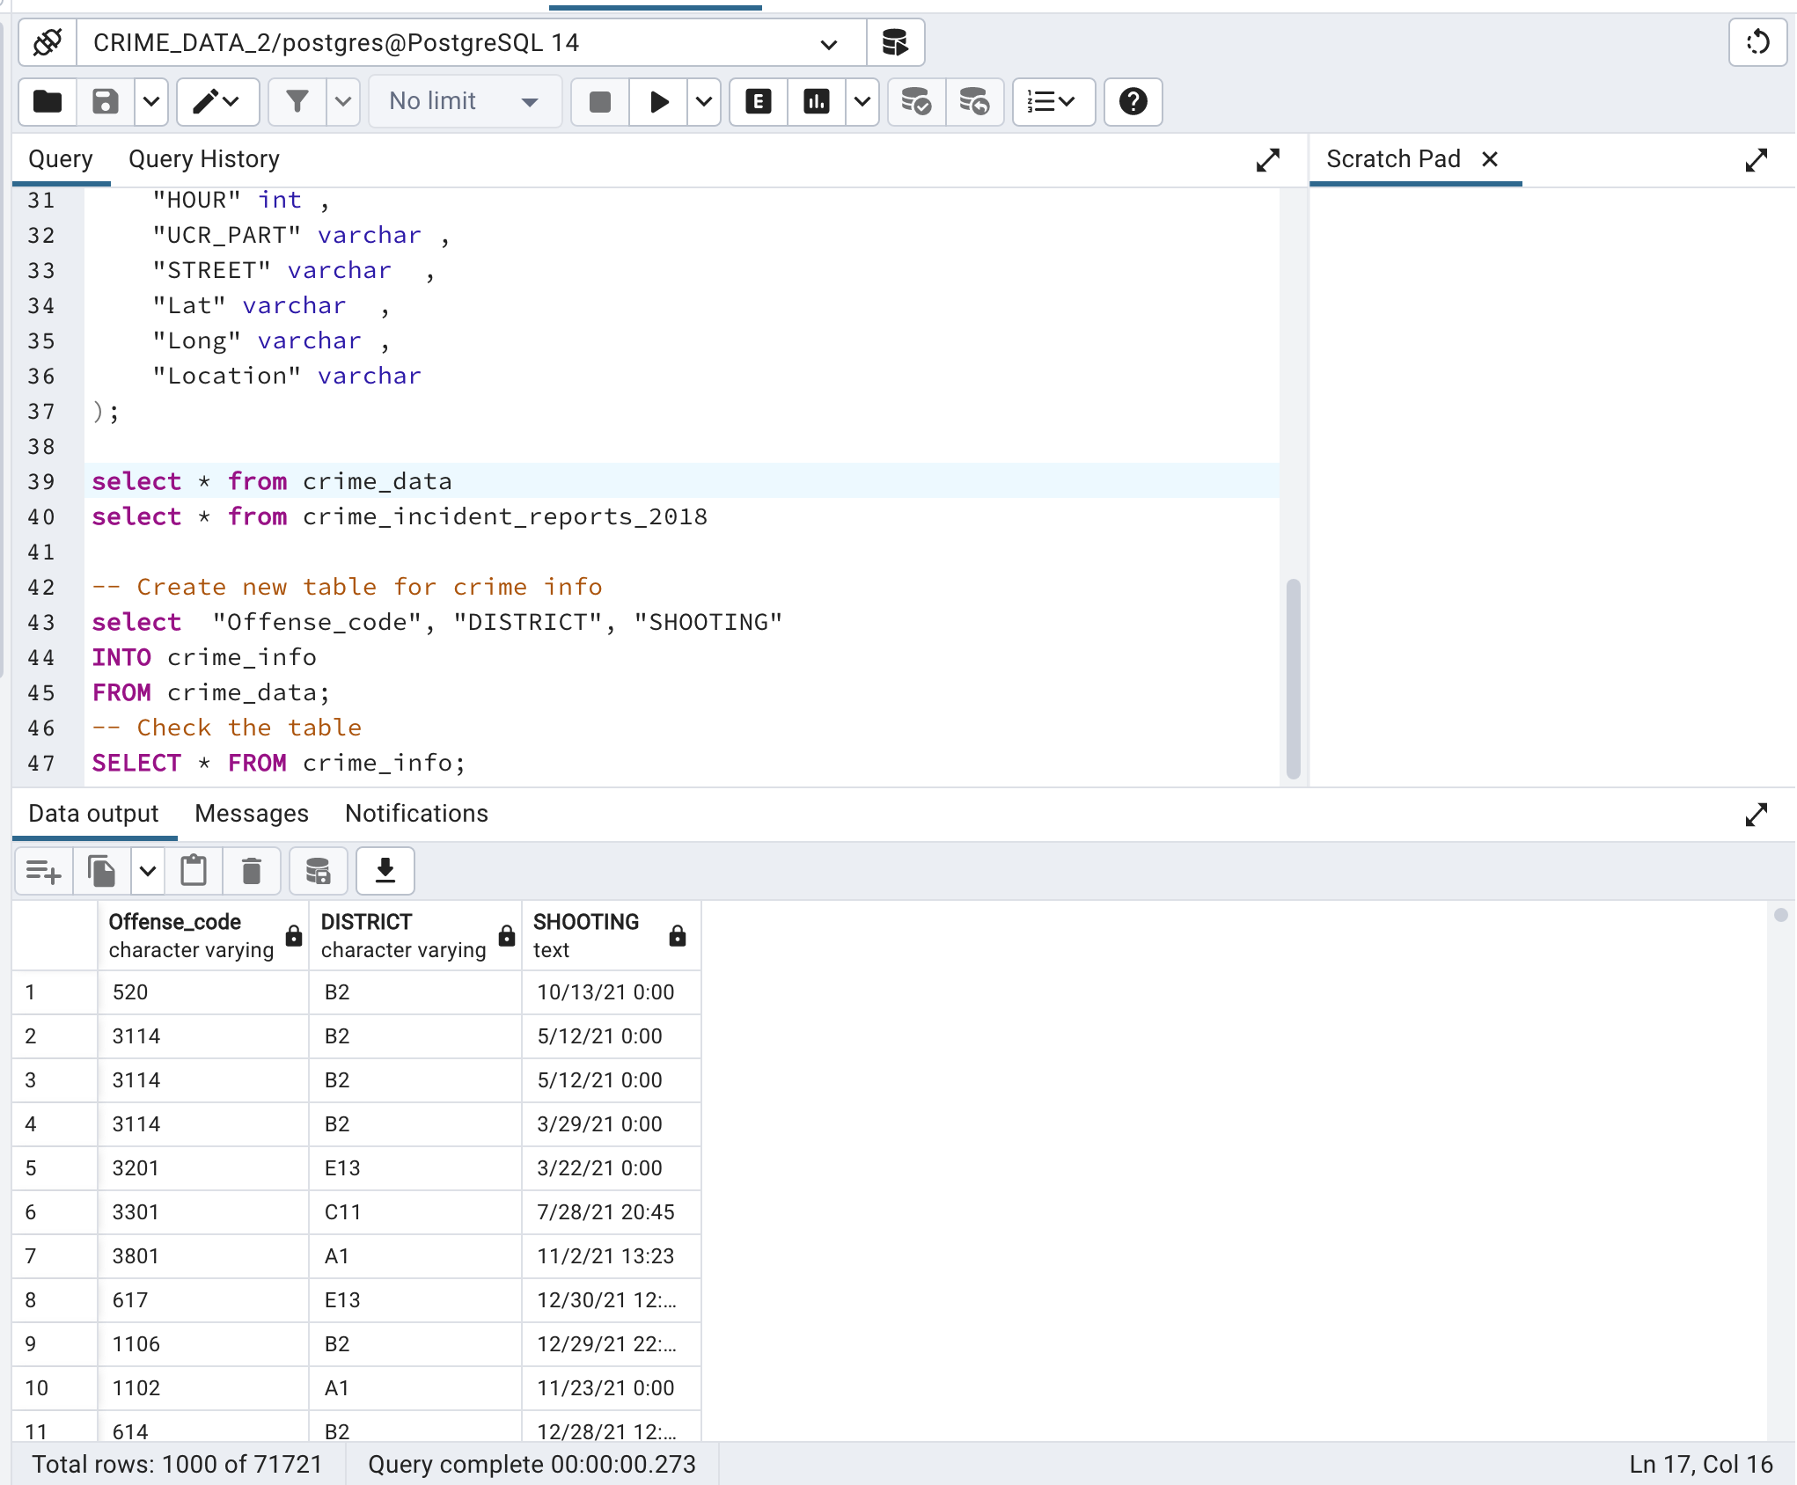
PG Admin/SQL
Pulling information from the database to create new tables for easier search.

Slide 10
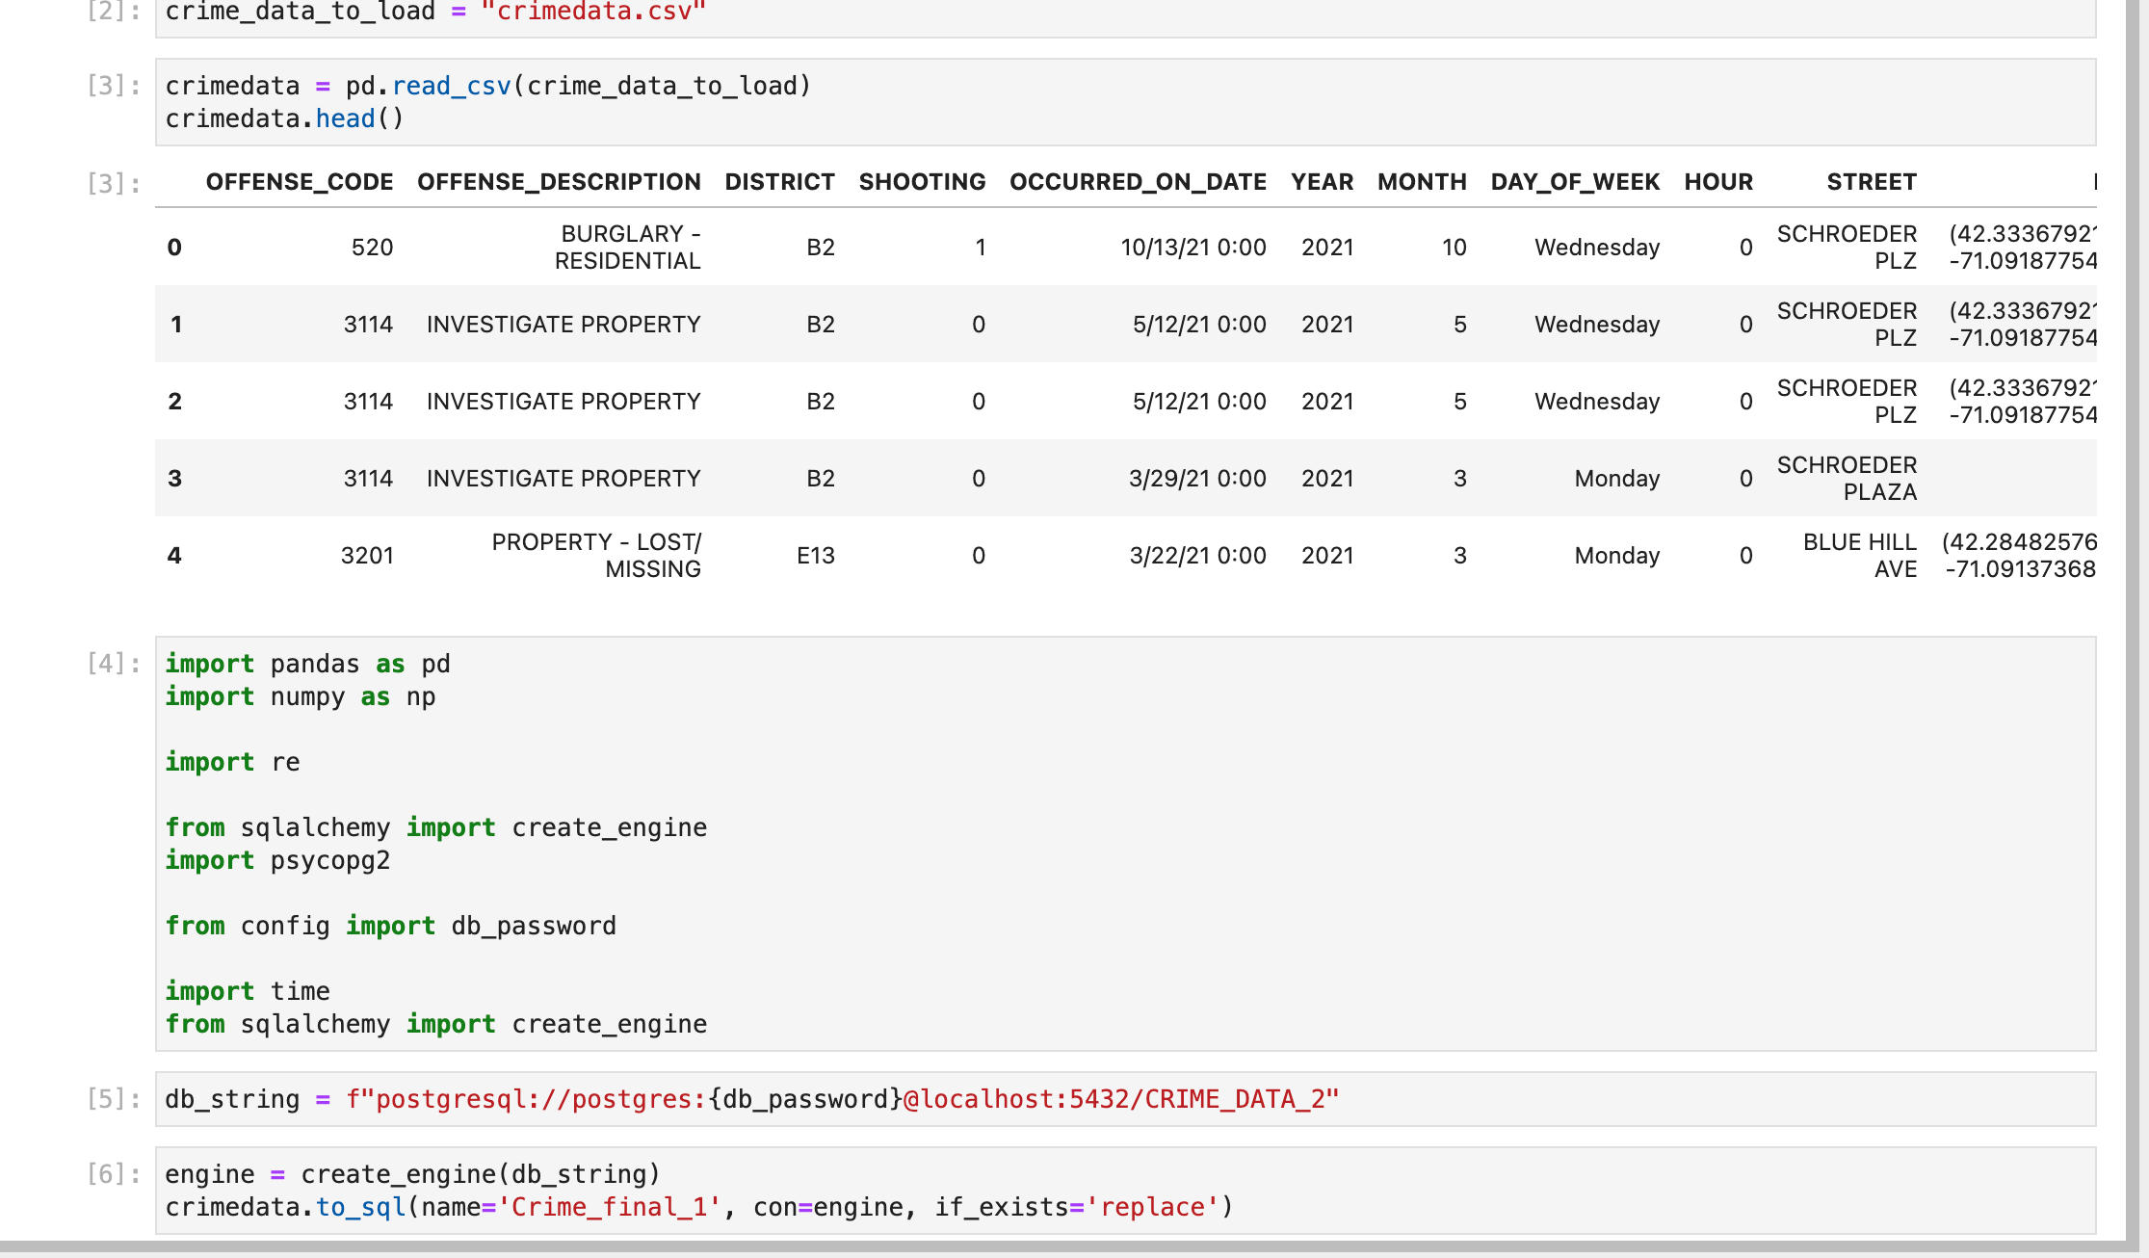
Linking SQL to Pandas
Linking our database to Pandas for machine learning model

Slide 11
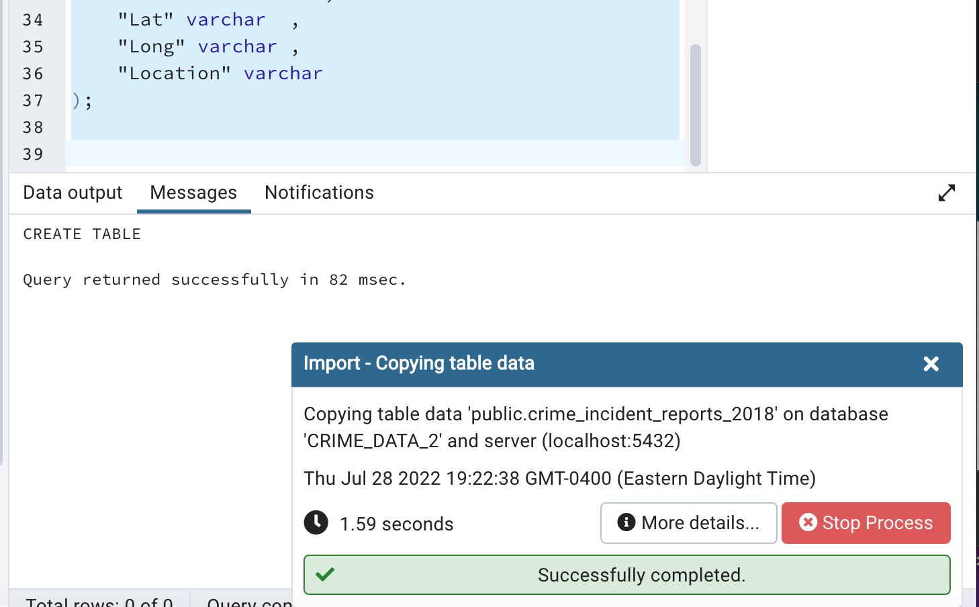
IMPORTING CSV INTO TABLES
Imported our data CSV into our database tables in Postgres/SQL

Slide 12
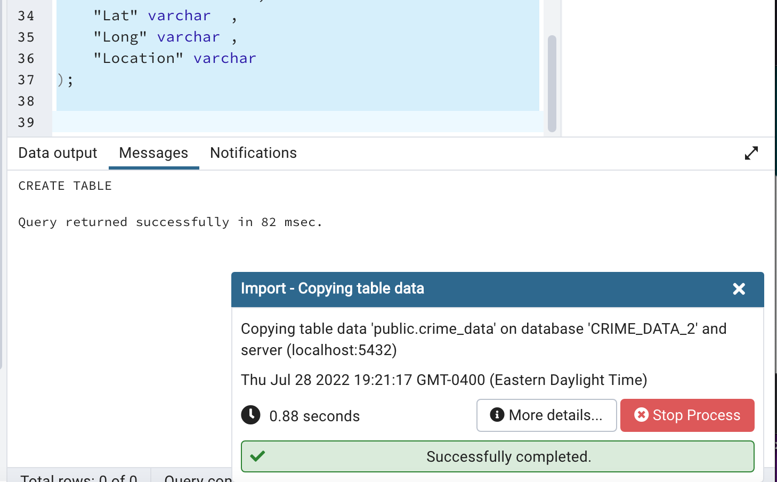
IMPORTING CSV INTO TABLES
Imported our data CSV into our database tables in Postgres/SQL

Slide 13

MACHINE LEARNING

Slide 14
MACHINE LEARNING
K-Means clustering with PCA (principal component analysis): unsupervised machine learning model
To help predict type of crime within a certain area (District)
Principal component analysis (PCA): a statistical procedure that allows you to summarize the information content in large data tables by means of a smaller set of “summary indices” that can be more easily visualized and analyzed.
Limitations vs Benefits and how we worked around the limitations
Preprocessing breakdown and presentation of the clusters
Notes:
The machine learning model chosen for this project was K-Means clustering with PCA (principal component analysis).
One of the reasons we chose this model was because we’re not looking for specific outputs, but rather for patterns to determine new patrols and/or stations for specific areas. Some of the limitations include clustering outliers by possibly giving outliers their own cluster, working exclusively only with numeric data, having to know the clusters ahead of time, and being prone to the curse of dimensionality. The benefits of this model include clustering the data to see patterns, it can scale to large data sets (since ours include 70,000+ data points), and it is relatively easy to use and can manipulate to suit our goals.

Slide 15
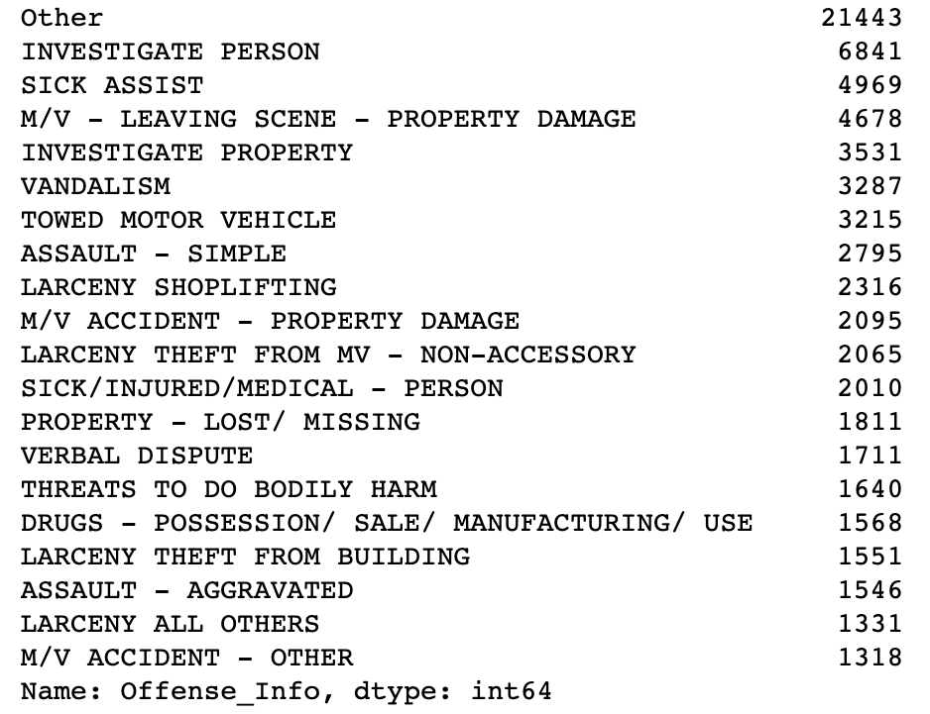
Binning the Offense_Info Column

Slide 16
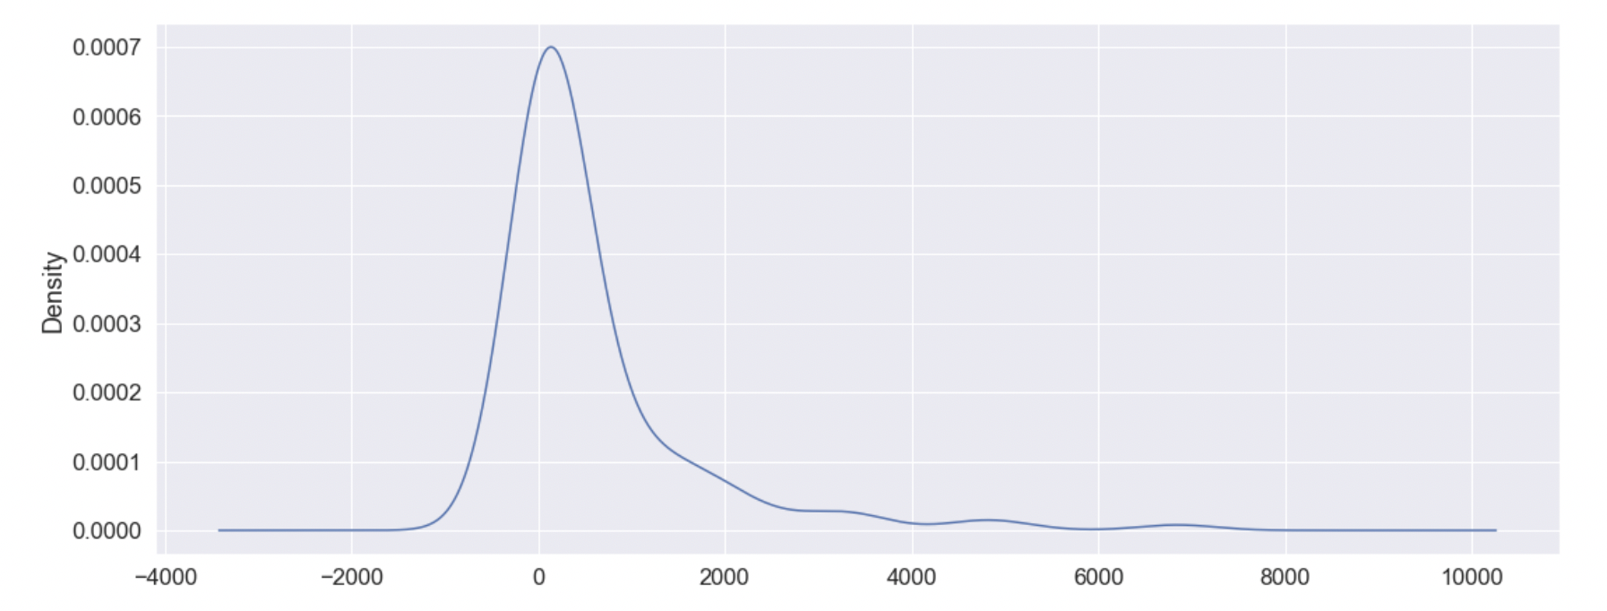
Offense Density Plot
Between 1000 and 1500

Slide 17
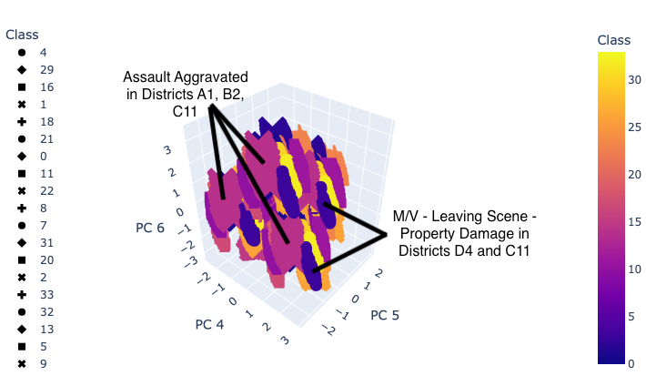
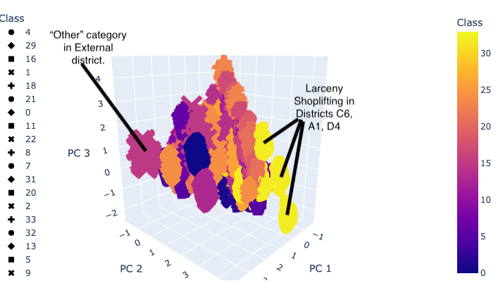
MACHINE LEARNING CLUSTER EXAMPLES

Slide 18
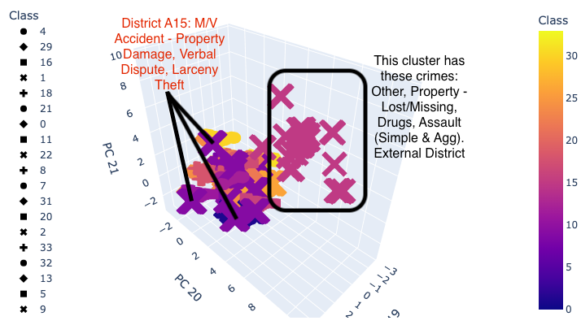
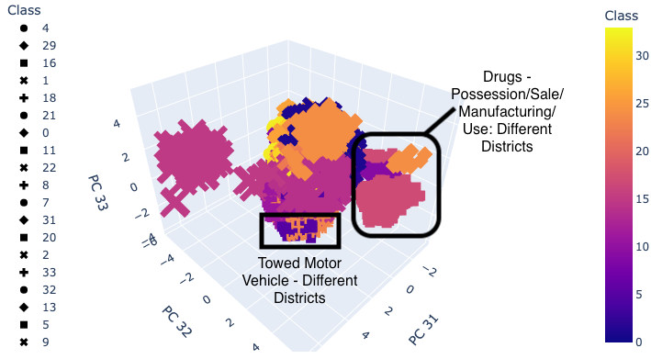
MACHINE LEARNING CLUSTER EXAMPLES

Slide 19

DASHBOARD

Slide 20

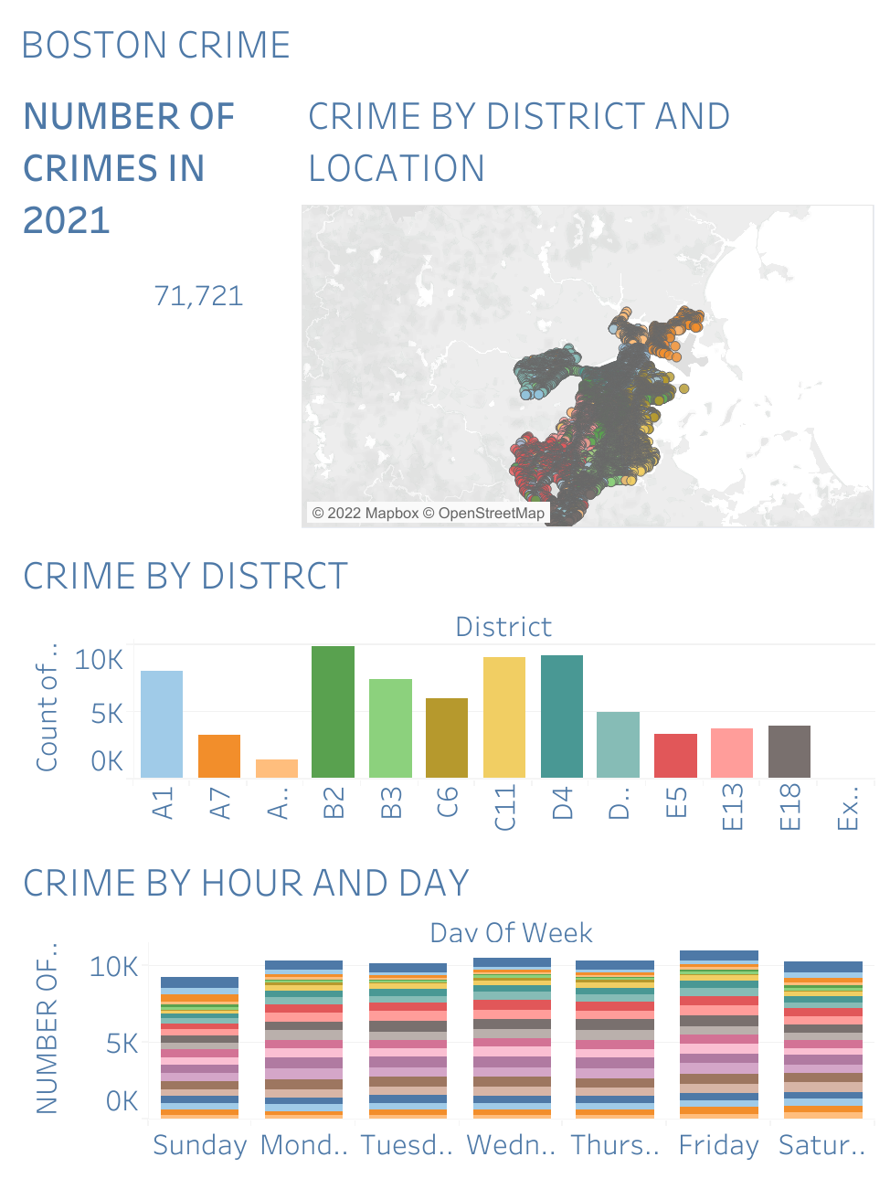
dashboard

Slide 21
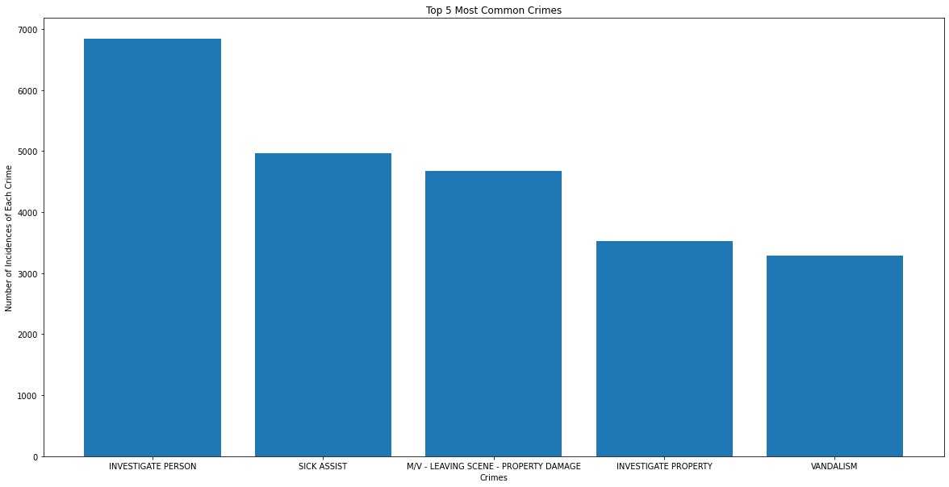
tOP 5 COMMON CRIMES

Slide 22
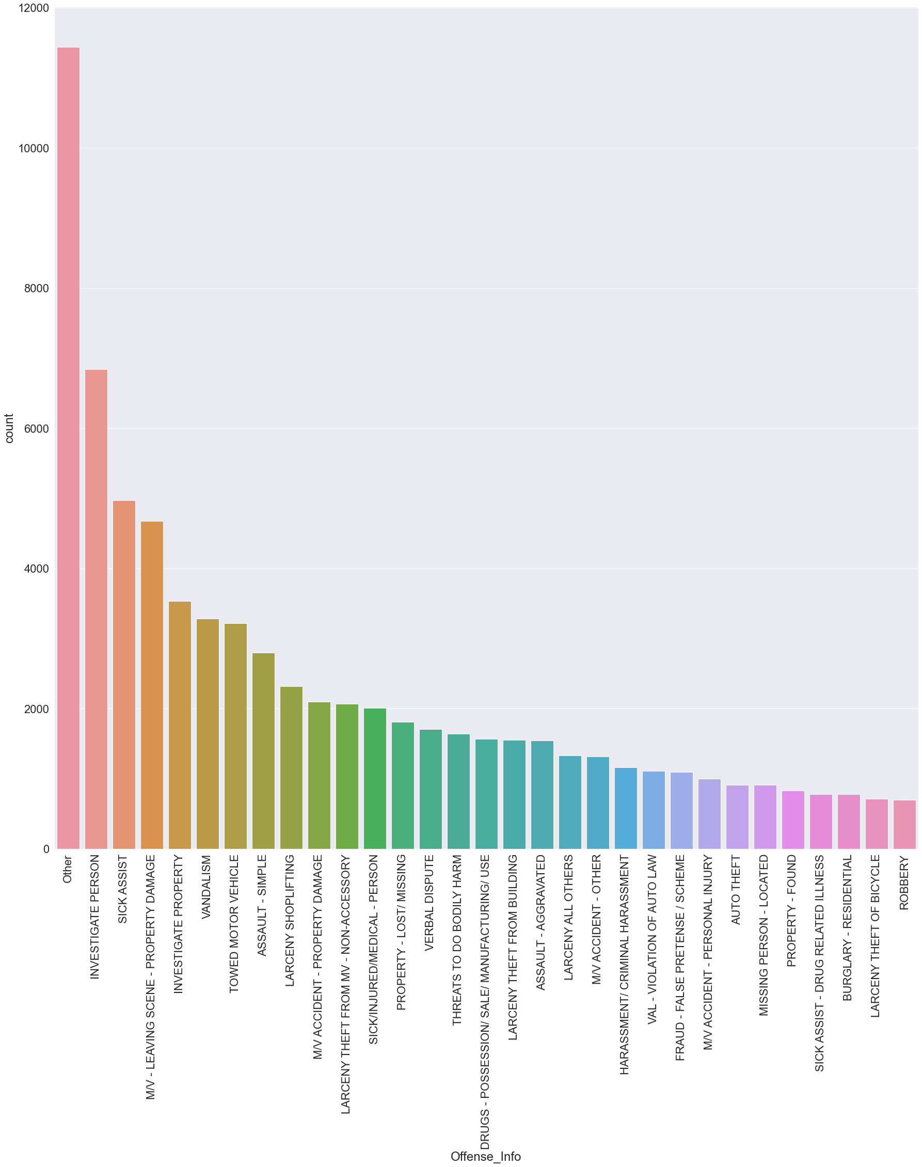
The Total Number of Crimes Based on Their Types in Descending Order

Slide 23
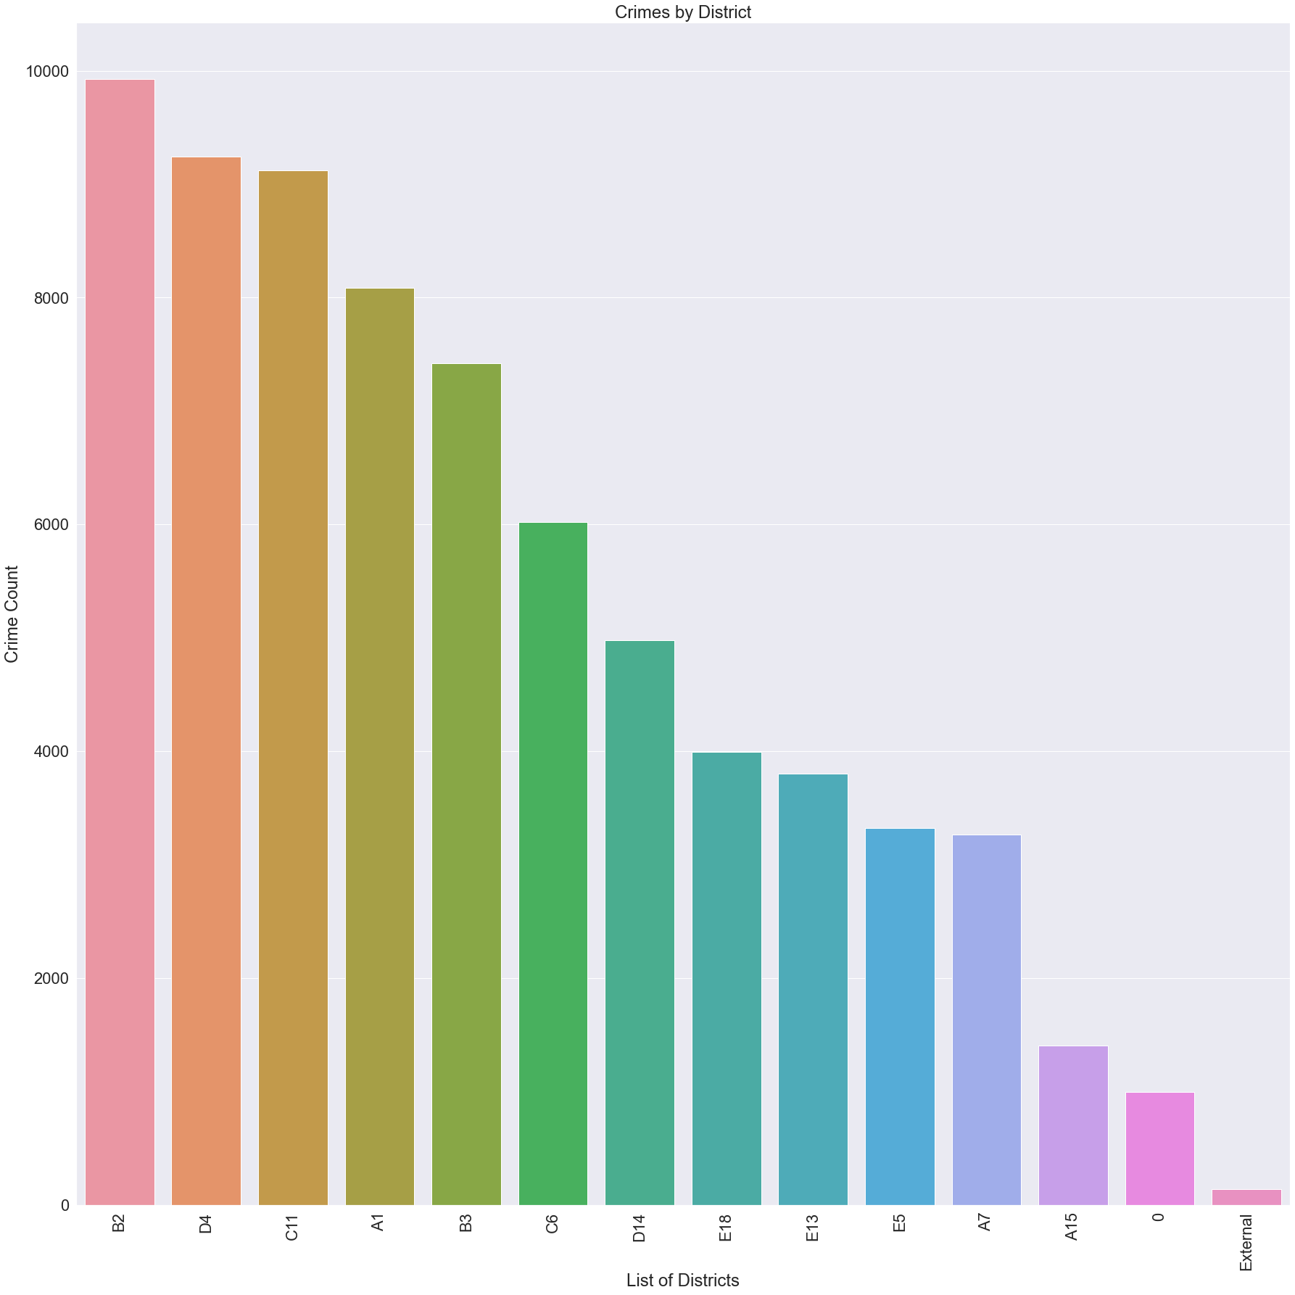
The Highest Number of Crimes Reported Based on Districts
A1 - Boston Downtown
A7 - East Boston
A15 - Charlestown
B2 - Roxbury
B3 - Mattapan
C6 - South Boston
C11 - Dorchester
D4 - South End
D14 - Brighton
E5 - West Roxbury
E13 - Jamaica Plain
E18 - Hyde Park

Slide 24
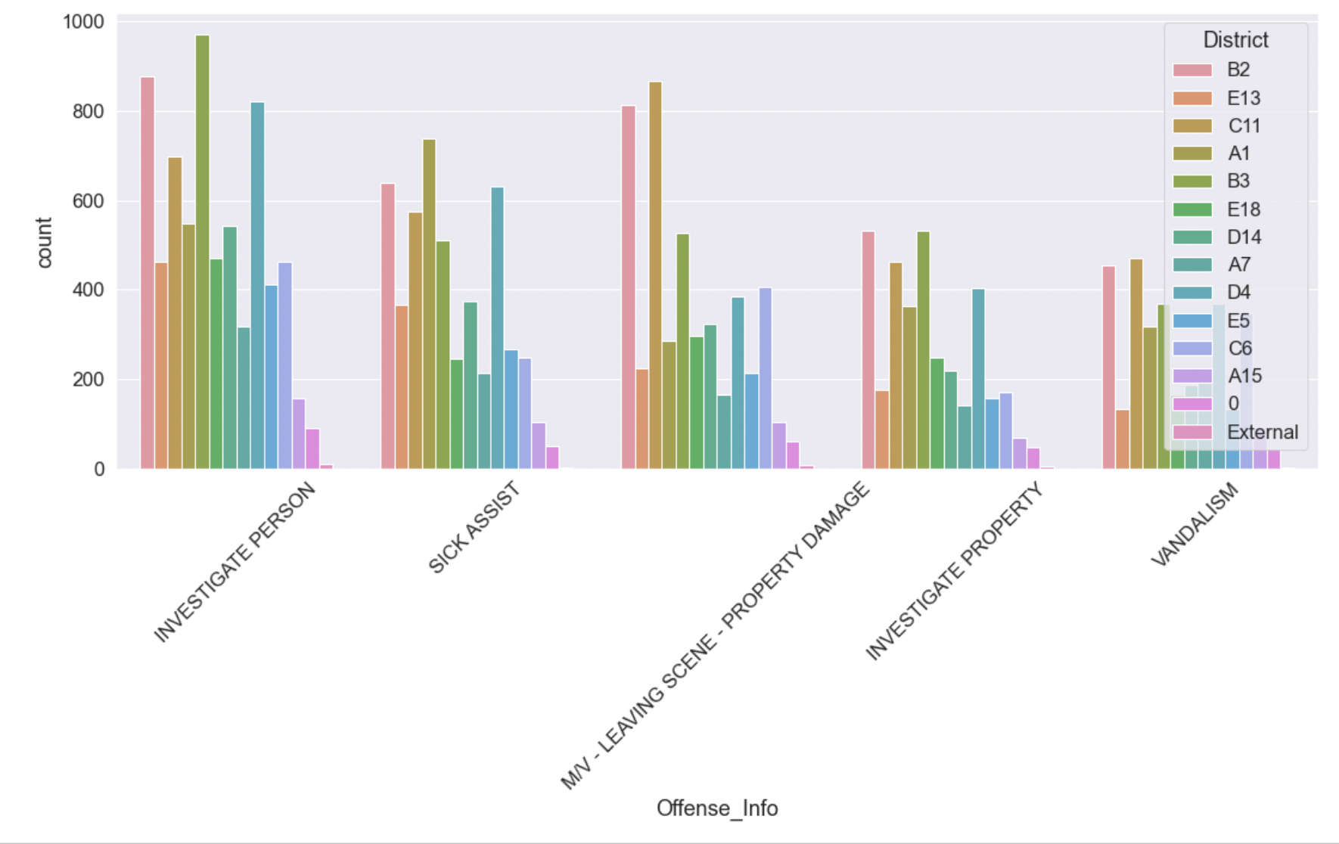
Offenses by District- 1
A1 - Boston Downtown
A7 - East Boston
A15 - Charlestown
B2 - Roxbury
B3 - Mattapan
C6 - South Boston
C11 - Dorchester
D4 - South End
D14 - Brighton
E5 - West Roxbury
E13 - Jamaica Plain
E18 - Hyde Park

Slide 25
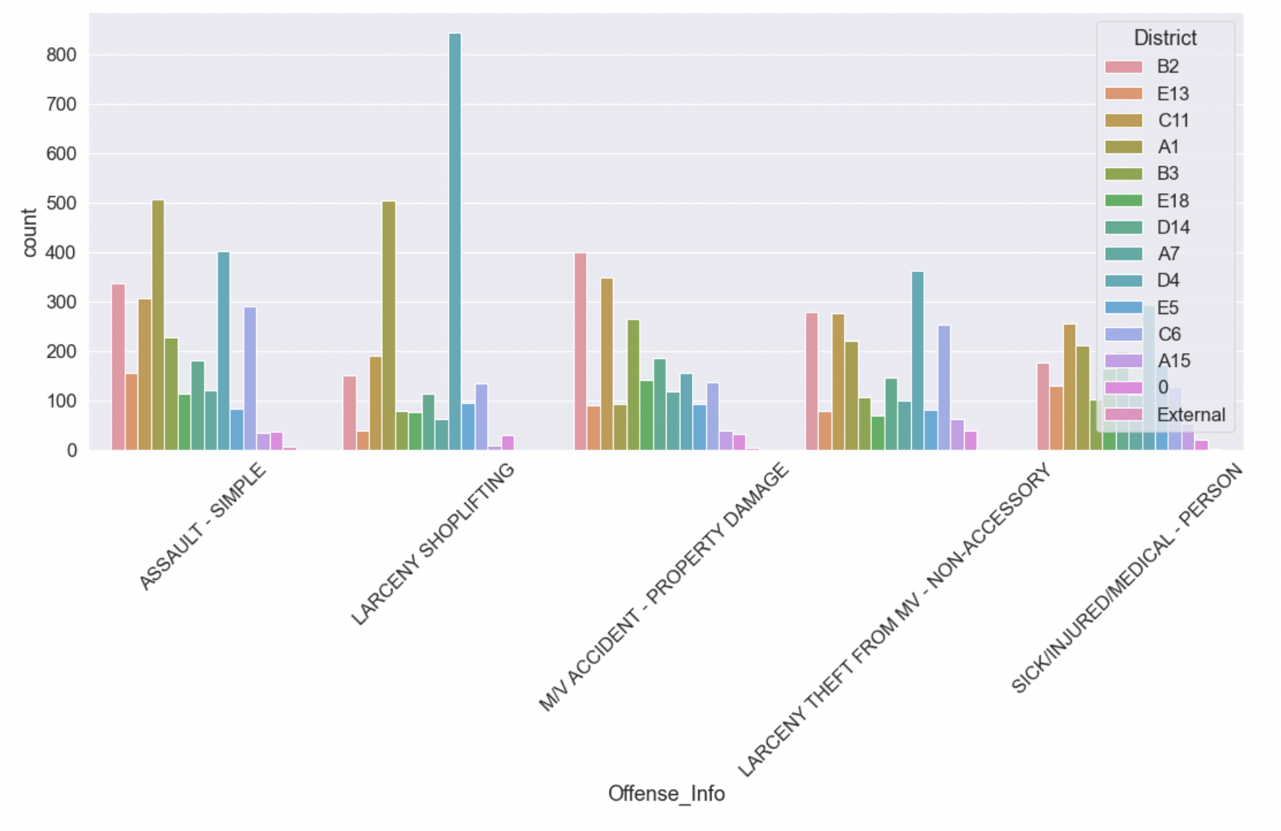
Offenses by District-2
A1 - Boston Downtown
A7 - East Boston
A15 - Charlestown
B2 - Roxbury
B3 - Mattapan
C6 - South Boston
C11 - Dorchester
D4 - South End
D14 - Brighton
E5 - West Roxbury
E13 - Jamaica Plain
E18 - Hyde Park

Slide 26
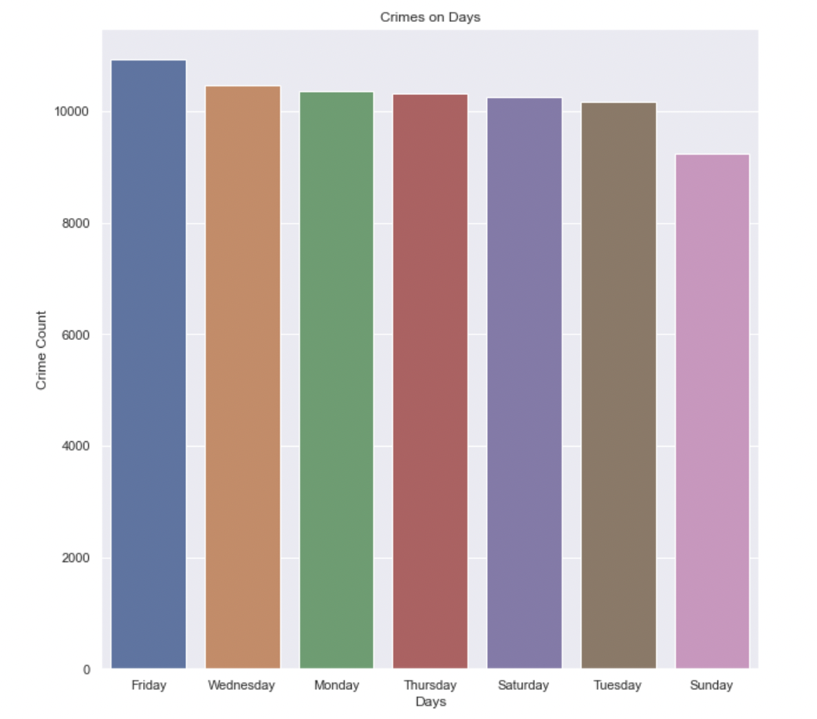
Crimes Based on Day of Week Ordered by Number of Crimes in a Day
Notes:
Friday : 10,937
Wednesday: 10,461
Monday: 10,354
Thursday: 10,324
Saturday: 10,254
Tuesday: 10, 164
Sunday: 9, 227
Total Crime: 71, 721

Slide 27
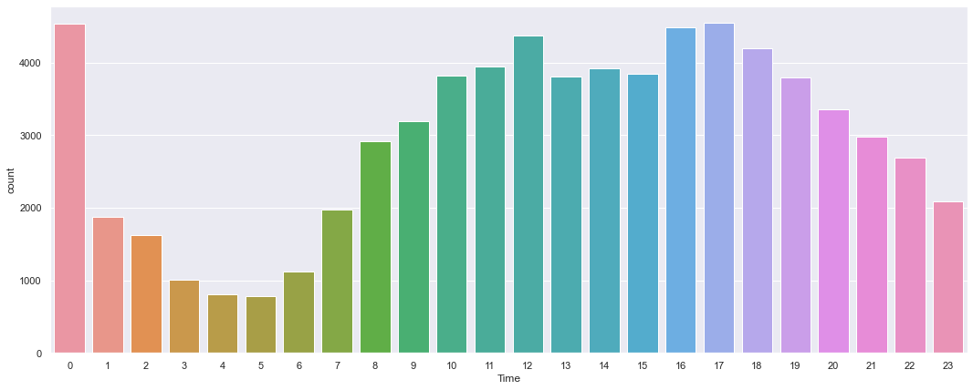
The Total Number of Crimes Based on The Hour of Day

Slide 28
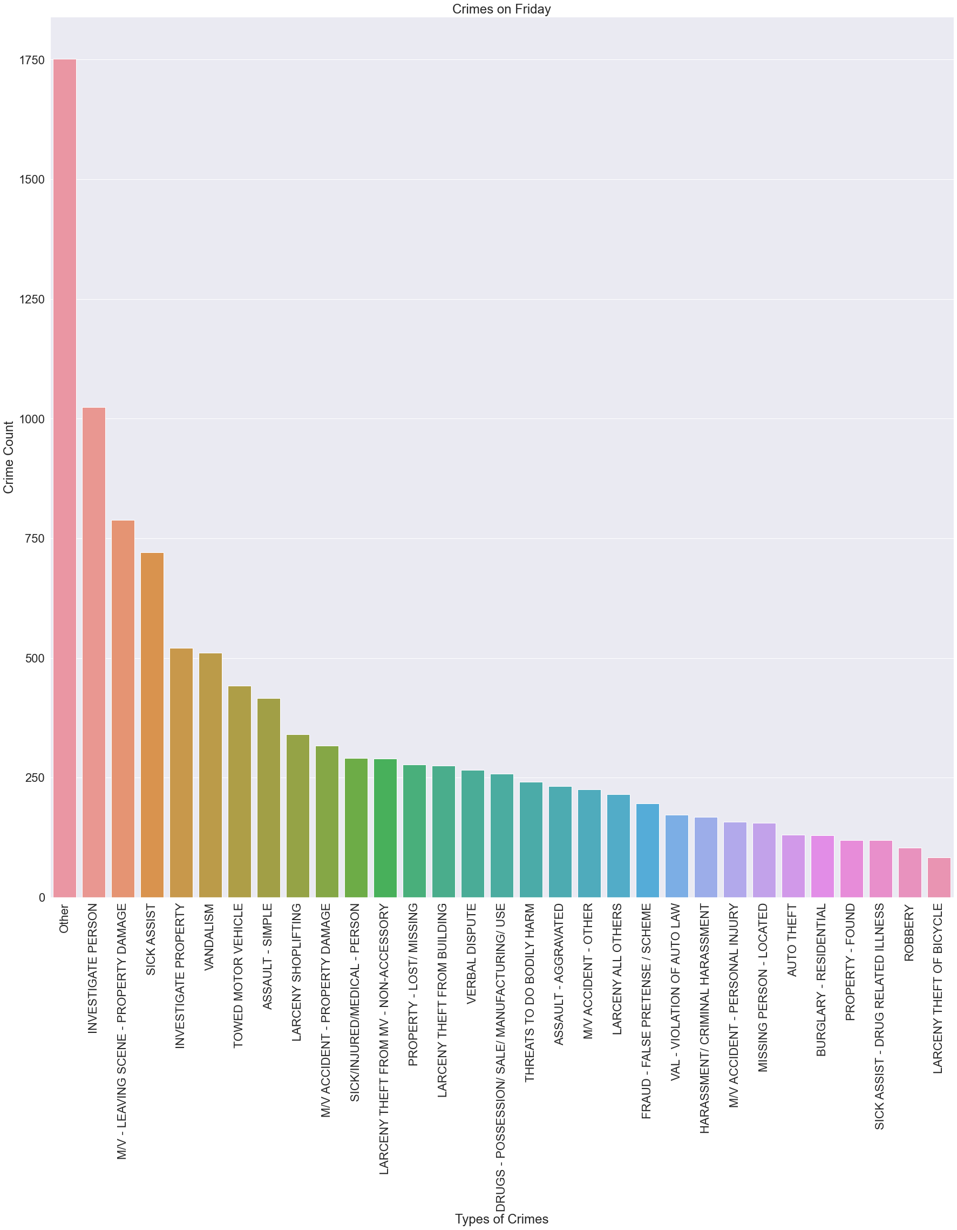
Different Types of Crimes That Happened on Friday in The Dataset

Slide 29
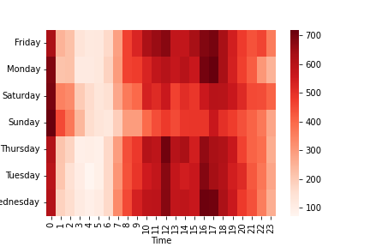
CRIMES BY DAY AND TIME

Slide 30
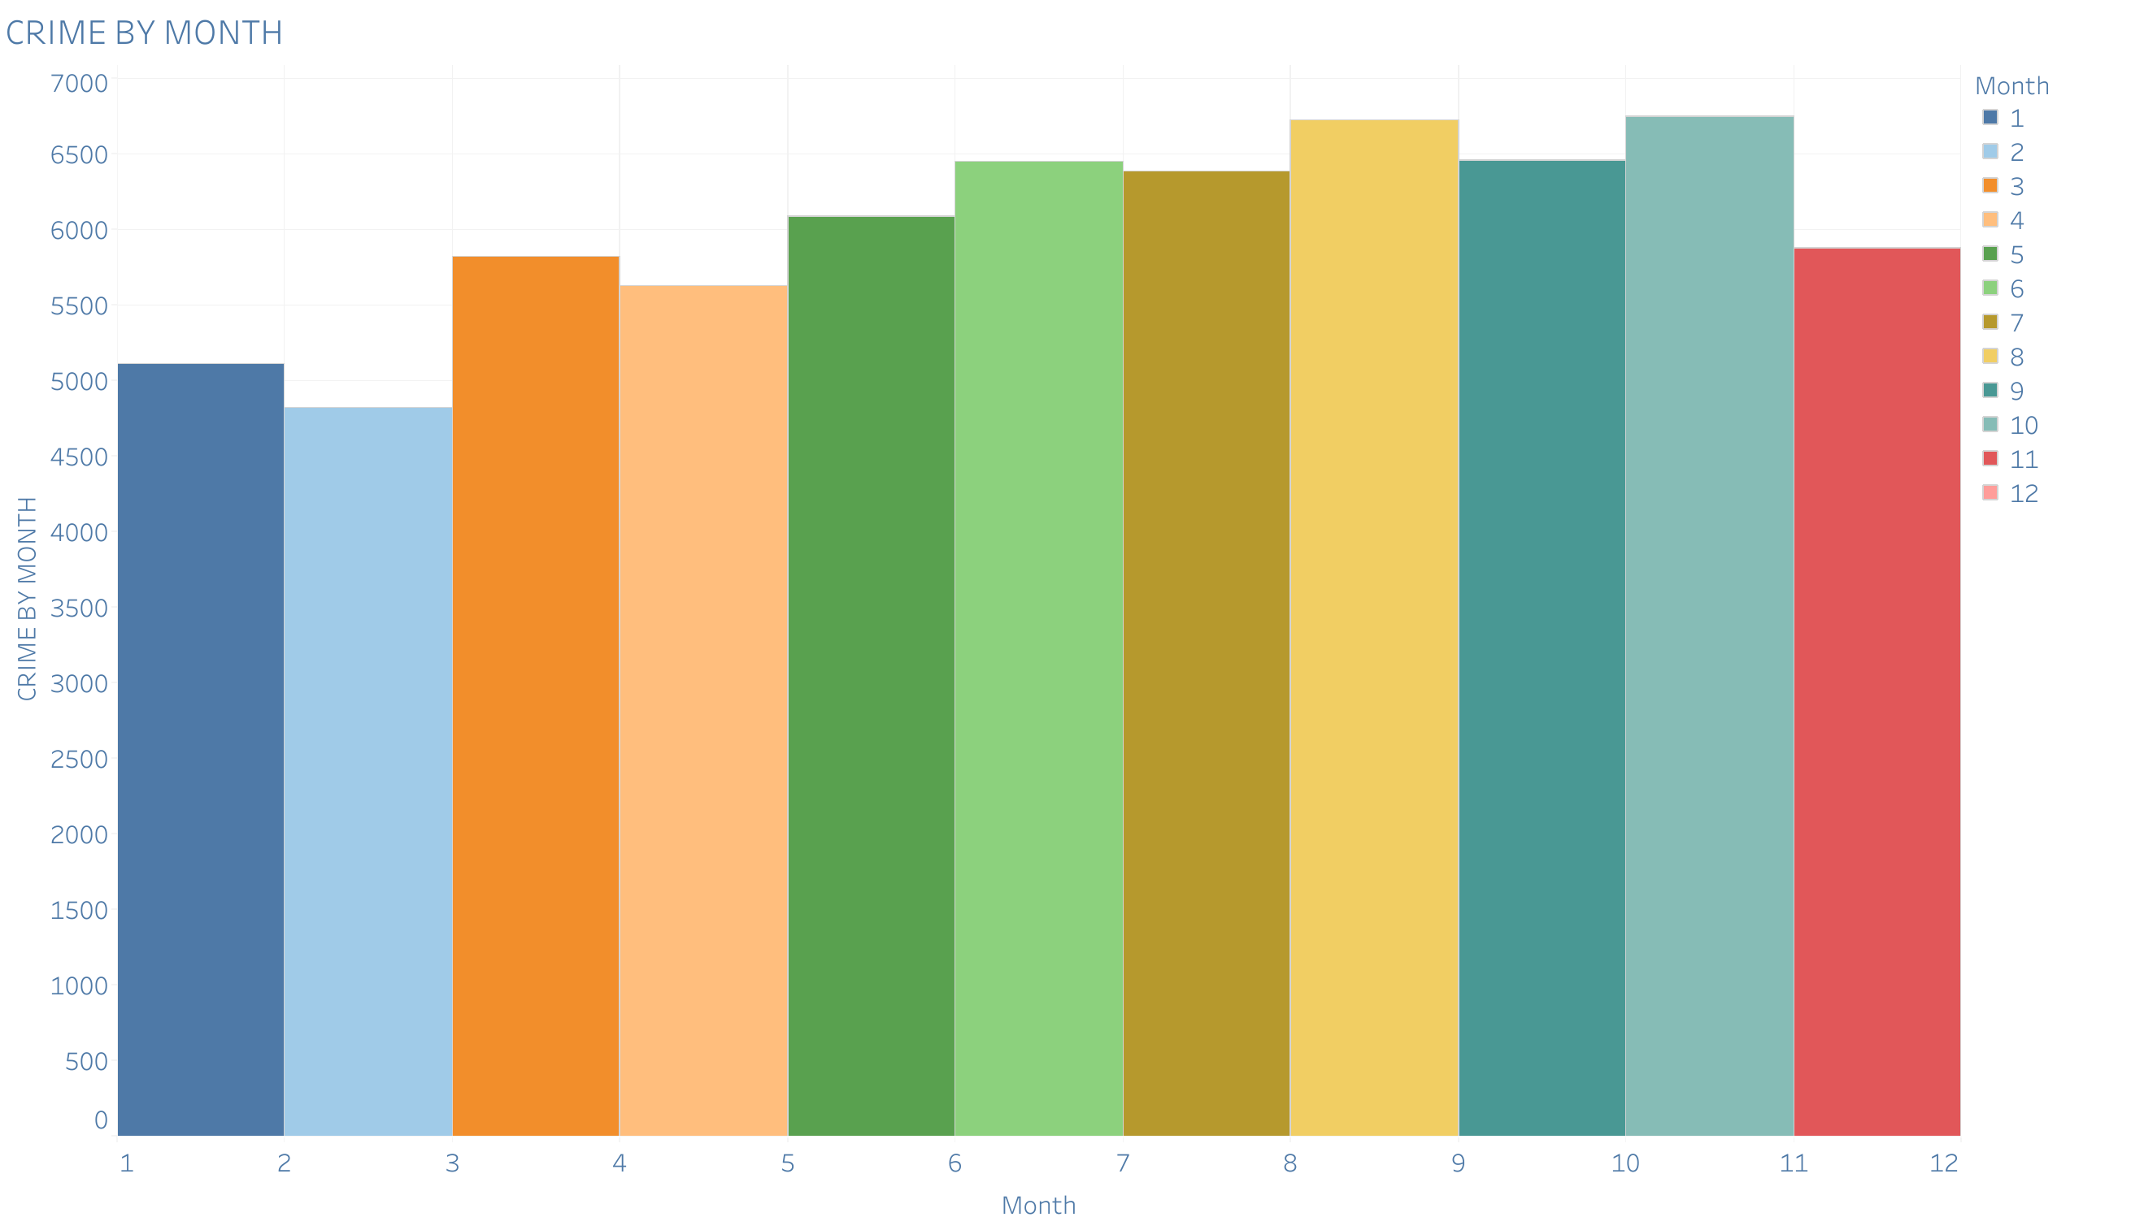
CRIME BY MONTH

Slide 31
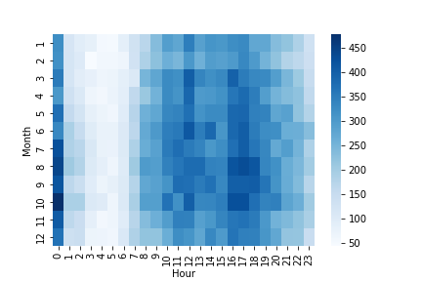
CRIMES BY MONTH AND HOUR

Slide 32
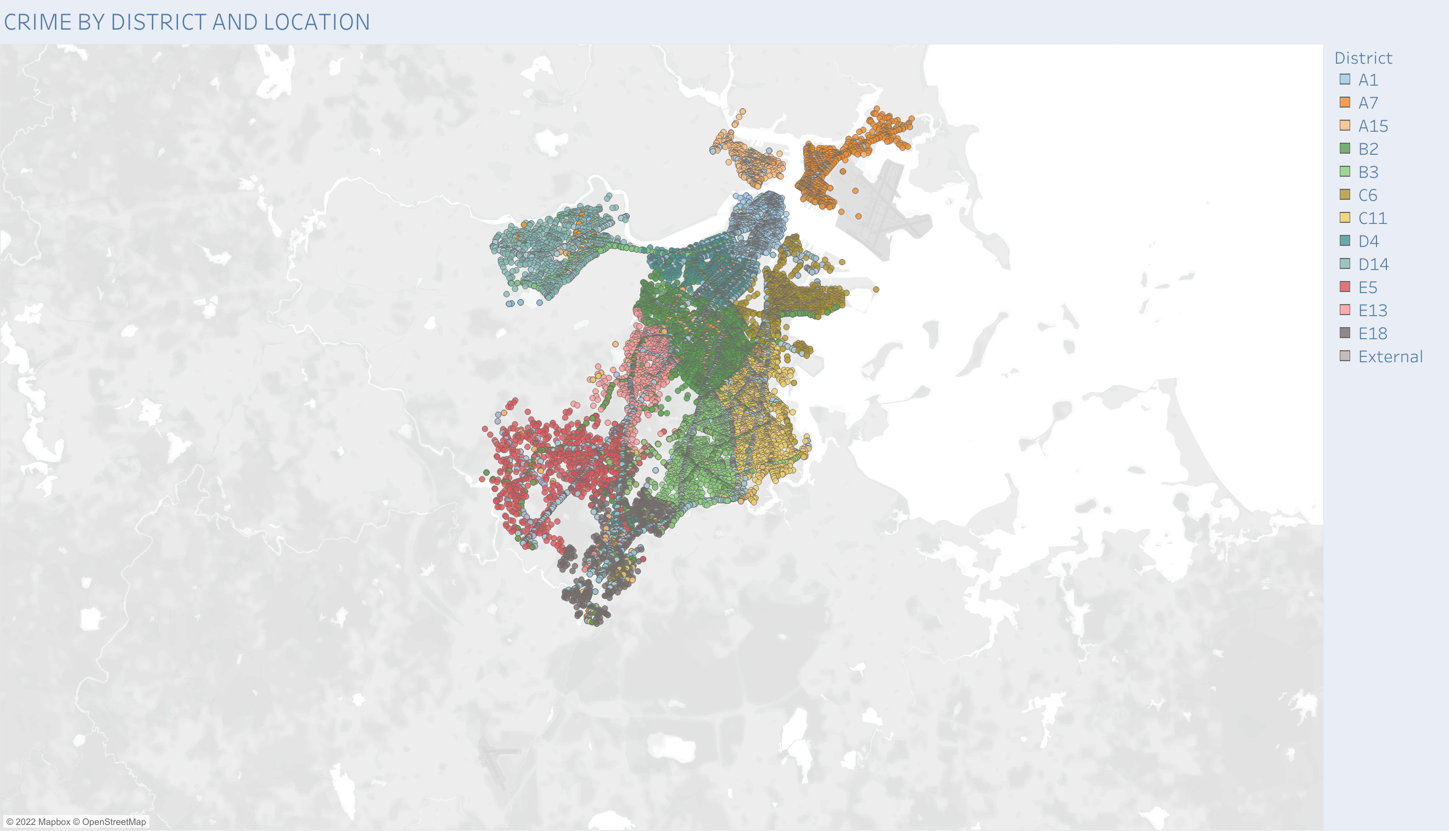

Slide 33
CONCLUSION
According to the result of the analysis, when examining the types of crime by month, Investigate Person, Leaving Scene - Property Damage, and Sick Assis are showing consistent staying at higher rates throughout the year than other crimes.
The trend of crime by month suggests that crime happens at lower rates and then gradually increases throughout the year before dipping in November, before the holidays.
Fridays during October see the most crime out of the year.
Districts B2 and D4 and C11, Roxbury and Mattapan, and Dorchester respectively, see the most crime in their areas.

Slide 34
Suggestions
The police patrols should be plentiful on Fridays and considering October also contains the most crime out of the year.
More clustering and more overlapping with different crimes on the map, more patrols in those areas, or the possibility of another department in that area can be suggested.

Slide 35
Thank you
Do You Have Any Questions?

